Slide 1
19th Annual Family CAFÉ Conference 2017
Rick Scott
Governor
Barbara Palmer
Director
Notes:
Good Afternoon Everyone. I’m Rhonda Sloan, the CDC+ Administrator, the Agency for Persons with Disabilities. I am also a Representative for my daughter who has been on the CDC+ Program since 2001, I live the program each day and hope that you will find this presentation very informational and help you determine if the CDC+ program is right for you. How many people in the audience are already on the program? Or on the waiting list? Let’s begin

Slide 2
Overview of Presentation
CDC+ Tools
Being Creative
Updates
Notes:
This presentation will provide information about the CDC+ Program tools, and Updates.
One of the best tool CDC+ offers is our website, I will walk through it and show you where to find the information that is available.
We will talk about how to be creative in CDC+
We will show you some of what is too come.

Slide 3
CDC+ Website http://apd.myflorida.com/cdcplus/
3
Notes:
Let’s go around the room, how many of you are currently on CDC+.
Florida was one of the first 3 states to have a self directed program. The other 2 were Ark and NJ.
In CDC+ the consumer has “Budget authority” and “employer authority”.
CDC+ is based on person centered planning which can be described as a plan of life.

Slide 4
4
Notes:
Announcements is the first section you will see as you scroll down the page.
We post important topics

Slide 5
Notes:
As you continue to scroll down, you will see more announcements

Slide 6
Notes:
Continue to scroll

Slide 7
Notes:
I know there have been issues with the Background Screening clearing house. We send up all issues that are reported to CDC+.
Be sure to go out on the clearinghouse once a month to keep your account active.

Slide 8
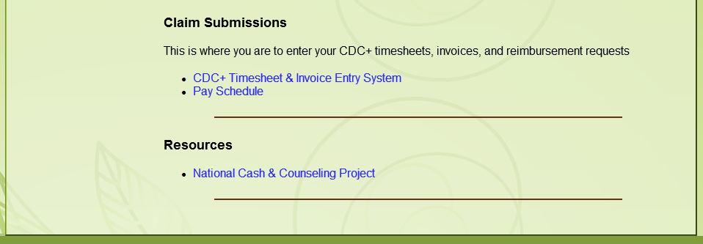
Notes:
At the bottom of the CDC+ website you will find:
a link to the Timesheet and Invoice Entry System
Current Pay schedule

Slide 9
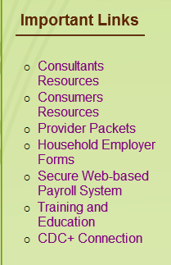
IMPORTANT LINKS

Slide 10
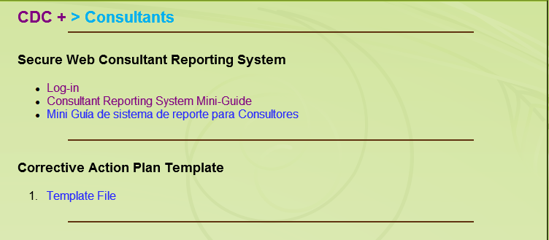
Consultants Resources Link
10
Notes:
Your consultant can obtain a copy of your monthly statement through the consultants quick link.
There is also a template they can use for a Corrective Action Plan.

Slide 11
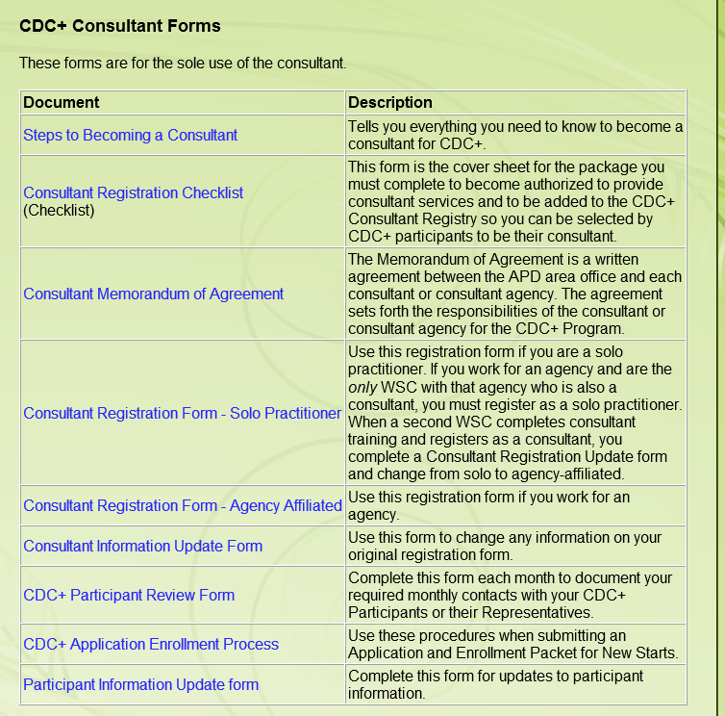
Consultants Resources (cont’d)
11
Notes:
The consultants quick link also provides a new Consultant the documents that will be needed to enroll as a Consultant with CDC+
Beginning in December CDC+ streamlined the consultant enrollment process and has enrolled 33 new consultants as of May 31.
There is also another document in the consultant quick link titles the CDC+ Participant Review Form. This form is to be completed each month to document the monthly contacts that are required by your consultant. The manner of contact is the consumers choice. Face

Slide 12
Consumers Resources Link
Notes:
The Consumer quick link is probably the most used by consumers and their representatives.
The CDC+ Handbook is the rule handbook for CDC+.
It provides definitions, a list of services that can be purchased in CDC+.
description of everything service -
Limitations and special conditions – age requirement of consumer is an example of this
Provider qualifications – age requirements, training requirements, licenses that may be required
Service type – restricted or unrestricted
The How-to Guide is quick reference tool on how to do certain things in CDC+.
The Appendix to How-To Guide is the forms that are used in CDC+

Slide 13
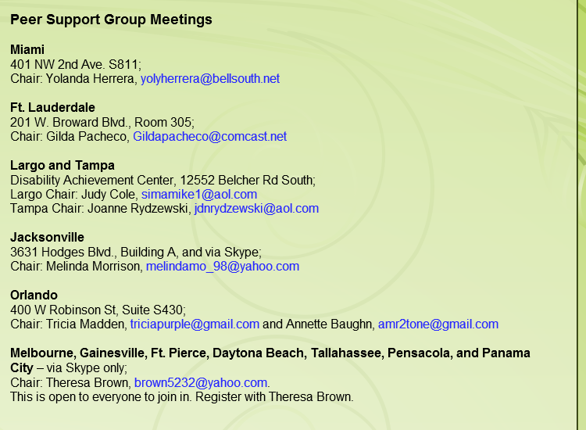
Consumers Resources (cont’d)
Notes:
On the consumers quick link, we provide the contact information for the chairs of the peer support groups. If the peer support group chairs provide CDC+ with the dates and times their meetings are held, they will be listed in the CDC+ Connection newsletter each month.

Slide 14
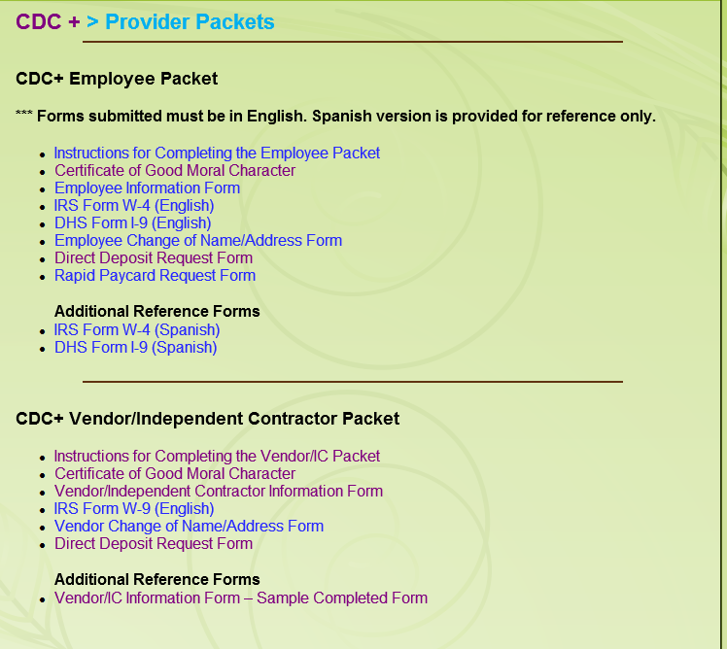
Provider Packets Link
Notes:
The Packets you would use for your Directly Hired Employees, your independent contractors and Agency Vendors can be found using this quick link.
There are also samples available also

Slide 15
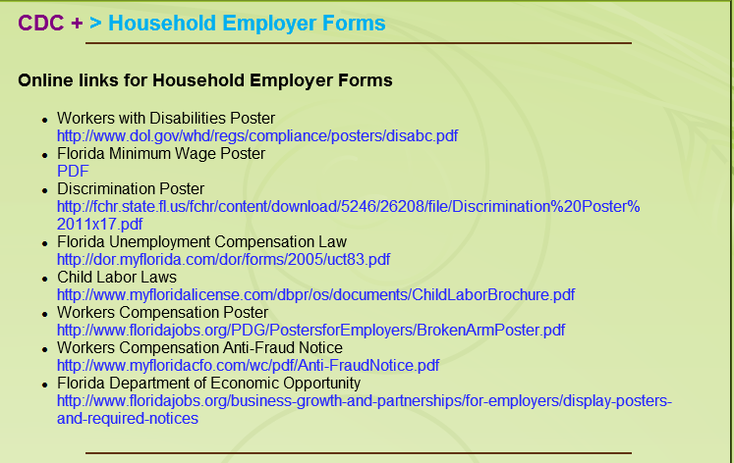
Household Employer Forms Link
Notes:
When an individual enrolls into CDC+, they become a domestic household employer.
This quick link will provide all the employer forms that you will need. Pay close attention to Floridas Child Labor Laws.
These signs are available in Spanish also on the website
The State of Florida and APDCares.org (APD) do not control or guarantee the accuracy, relevance, timeliness or completeness of information contained on a linked website.
APD does not endorse the organizations sponsoring linked websites and does not endorse the views they express or the products/services they offer.
APD cannot authorize the use of copyrighted materials contained in linked websites. Users must request such authorization from the sponsor of the linked website.
APD is not responsible for transmissions users receive from linked websites

Slide 16
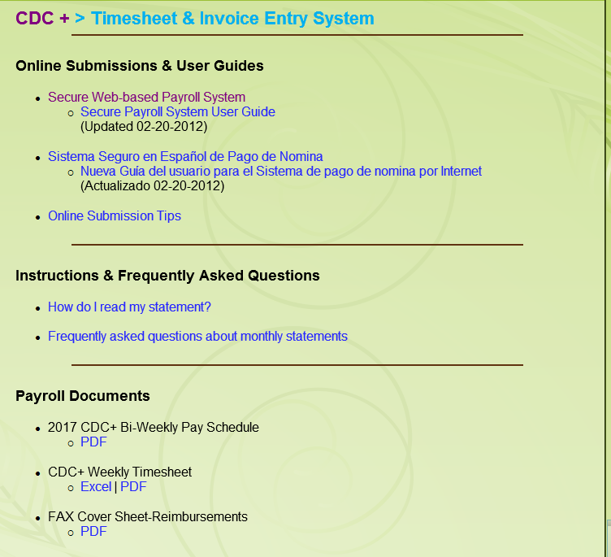
Secure Web-based Payroll System Link

Slide 17
Secure Web-based Payroll System

Slide 18
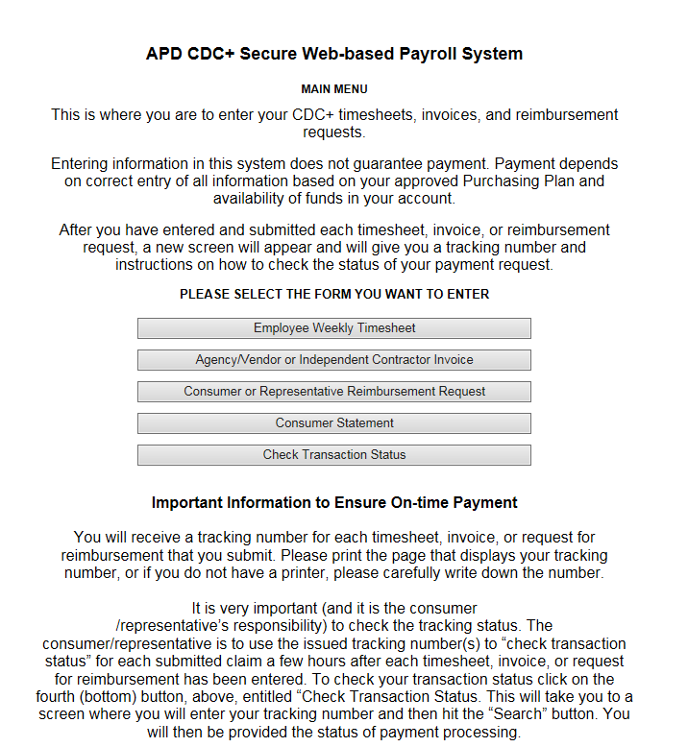
Secure Web-based Payroll System (continued)
Notes:
There is also a link to a Spanish version

Slide 19
Secure Web-based Payroll System (continued)

Slide 20
Secure Web-based Payroll System (continued)

Slide 21
Secure Web-based Payroll System (continued)

Slide 22
Secure Web-based Payroll System (continued)
Notes:
The consumer statement is mailed to the consumer’s address on file unless we have been given another address, the representative and get a copy of the monthly statement here.
It is very important (and it is the consumer /representative’s responsibility) to check the tracking status. The consumer/representative is to use the issued tracking number(s) to “check transaction status” for each submitted claim a few hours after each timesheet, invoice, or request for reimbursement has been entered. To check your transaction status click on the fourth (bottom) button, above, entitled “Check Transaction Status. This will take you to a screen where you will enter your tracking number and then hit the “Search” button. You will then be provided the status of payment processing. If you receive the message, “Processing, please check back for an updated status,” please wait three to four hours and check back. If you enter payment information after 5 p.m. Eastern Time, processing may not be complete until the next morning. The APD payment system functions very effectively but in order to help us provide on-time payments you must check the transaction status on all Web submissions, and alert CDC+ staff immediately when you receive any message other than “Processing” or “Approved”.

Slide 23
Training and Education Link

Slide 24
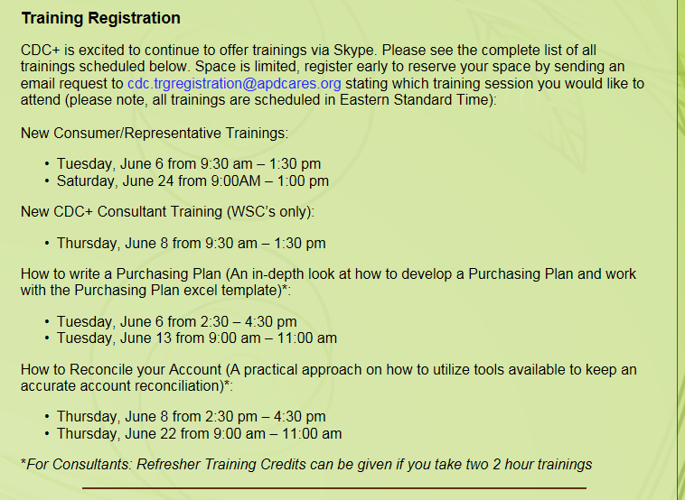
Training and Education (continued)

Slide 25
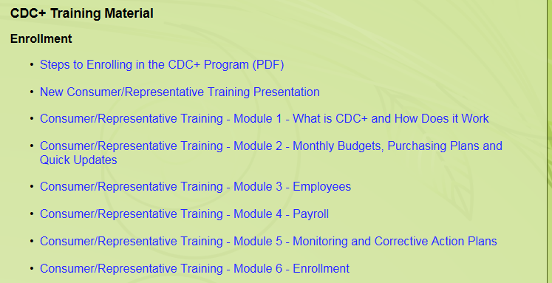
Training and Education (continued)

Slide 26
Training and Education (continued)

Slide 27
Training and Education (continued)

Slide 28
Training and Education (continued)

Slide 29
Training and Education (continued)

Slide 30
CDC+ Connection Link

Slide 31
BEING CREATIVE
Needs and goals identified in Support Plan still must be met
What is being creative?
How have some of you been creative?
Notes:
Even when being creative by purchasing different services or quantities, the needs and goals identified in the Support Plan still must be met.
What is being creative:
Being creative means solving a problem in a new way. It means changing your perspective. Being creative means taking risks and ignoring doubt and facing fears. It means breaking with routine and doing something different
Let’s talk about employment – a goal identified on a Support Plan is the individual wants a job. The individual is referred to Voc Rehab, he/she is told they are unemployable
The individual did not have any idea what a job entailed.
The representative writes a plan:
Show what a job is
The representative hired a companion and writes the job description to meet the requirements need to accomplish this goal to take the individual and job shadow someone on their job so they can understand what a job is

Slide 32
COMING SOON
Enhancements to:
APD CDC+ Secure Web-based Payroll System
Training will be provided
Guide will be developed

Slide 33
Enhanced APD CDC+ Secure Web-based Payroll System TIMESHEET ENTRY

Slide 34
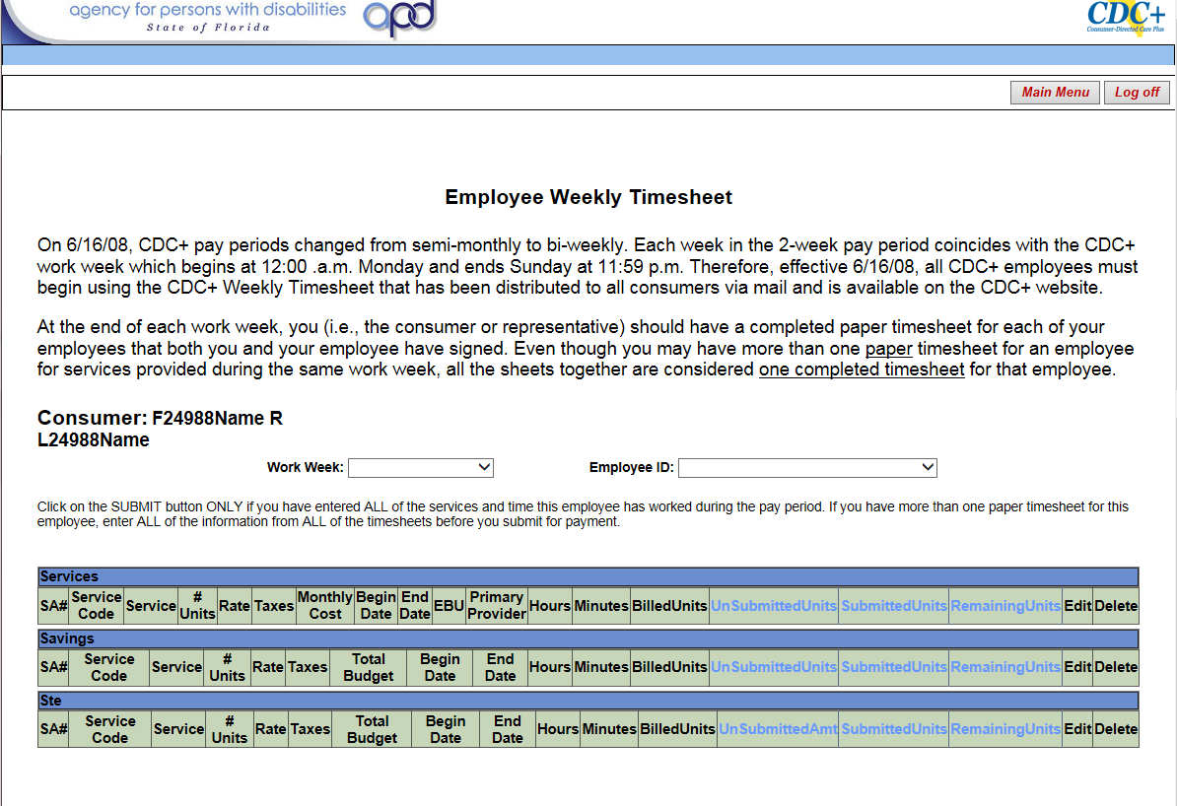
SELECT A WORKWEEK and PROVIDER

Slide 35
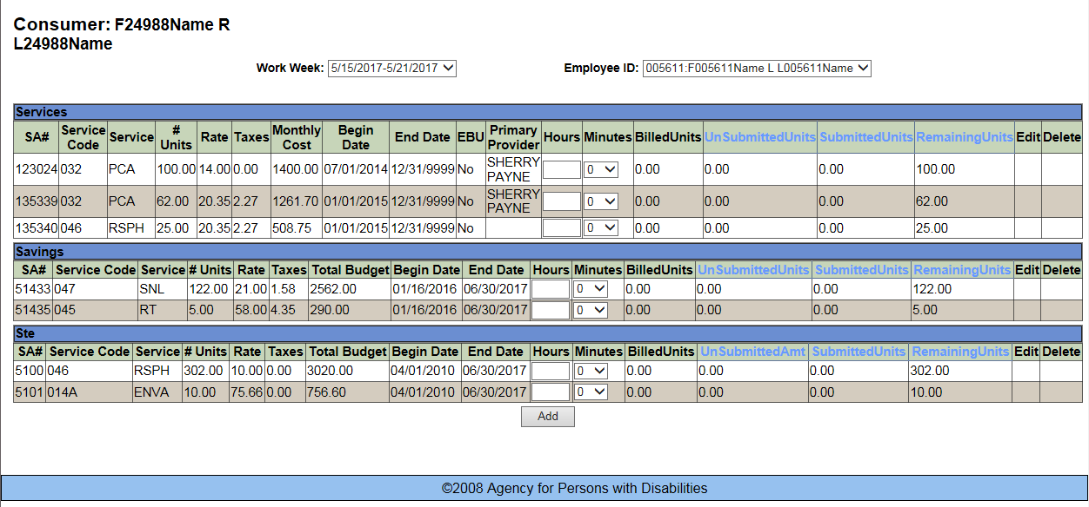
ADD TIMESHEET HOURS FOR THE PROVIDER

Slide 36
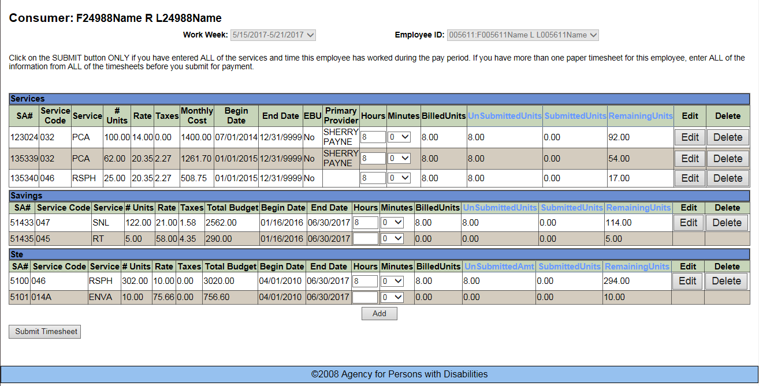

Slide 37
INVOICE ENTRY

Slide 38
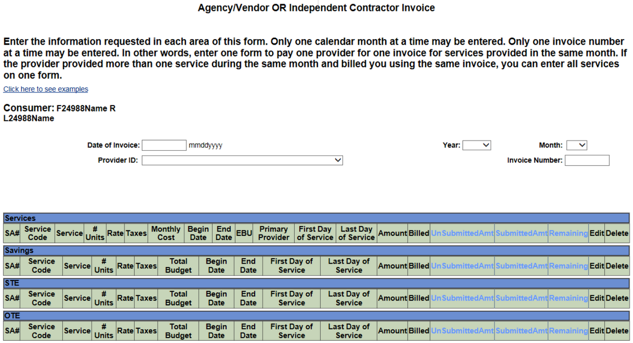
INVOICE REQUEST

Slide 39
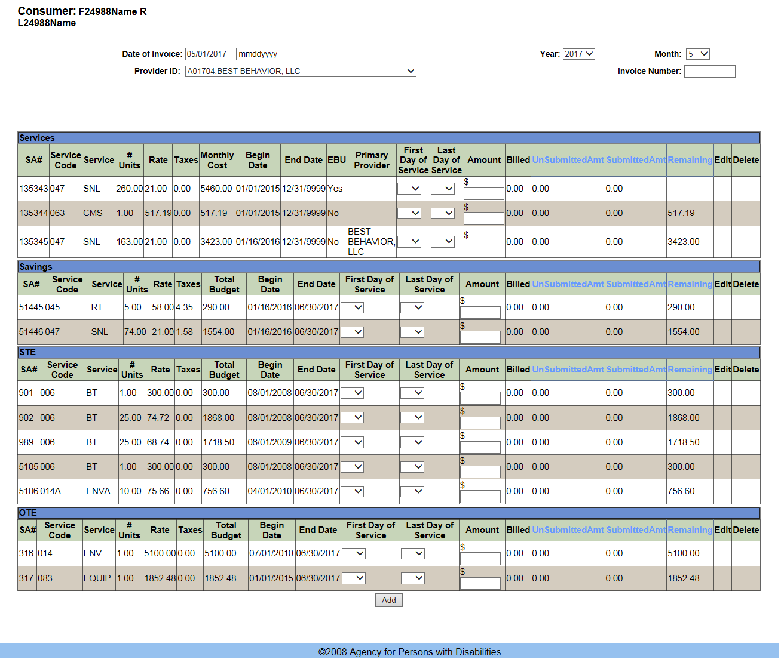
SELECT A DATE and PROVIDER

Slide 40
REIMBURSEMENT REQUEST ENTRY

Slide 41
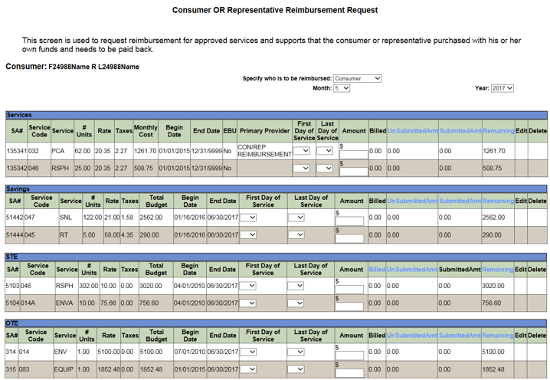
REIMBURSEMENT REQUEST

Slide 42
UPDATES
Informational emails are being sent monthly to those newly enrolled
Program requirements for submitting payroll
Reconciling the account
Adding Employee to BGS Clearinghouse roster
Providing Reconciliation and Purchasing Plan trainings
Consultant registration streamlined
Quick-updates are sent directly to CDC+ State office
Enhancements to F/EA System
Paid receipts and invoices are required for reimbursement submissions
Notices will be sent out for items not approved on the Savings page
Notes:
Updates of things that has or is occurring and also upcoming things
important information about program requirements for keeping and submitting Timesheets, Invoices and Reimbursements. Please read it and keep it for future reference. The information attached explains:
How and Why your Directly Hired Employees (“DHE”) must complete a weekly paper timesheet
Why the timesheet needs to be signed by both the DHE and you
How and When to submit DHEs time worked so that they will be paid
What to do with the invoices you receive from Independent Contractors (“IC”) and Agency Vendors (“A/V”)
How and When to submit the invoices so that your IC and A/V will receive payment
What documents you must keep for goods or services you have on you Purchasing Plan for Consumer/Representative Reimbursement
How to submit a request for Consumer/Representative Reimbursement
Record retention requirements
Reconciliation and Purchasing Plan Training
Consultant Registration Streamlined
Quick-ups are sent direct to CDC+State office
Enhancements to FEA System
Providing Reconciliation and Purchasing Plan trainings
Consultant Registration Streamlined
Quick-ups are sent direct to CDC+ State office
Enhancements to FEA System
Paid receipts and invoices are required for Reimbursement submissions
Notices will be sent out for items not approved on the Savings page – Due process rights

Slide 43
Q & A Session
43
Notes:
You can also list your questions on the index cards and I will get back to you.

Slide 44
Thank You
Customer Service is available Monday through Friday (8 a.m.–5 p.m. EST), excluding state holidays.
CDC+ Customer Service 1-866-761-7043
Rhonda Sloan, CDC+ Administrator
Rhonda.Sloan@apdcares.org 850-414-5070
Patricia Rush, Program Administrator
Patricia.Rush@apdcares.org 850-413-6694
44

